Slide 1
Dummies and interaction in logistic regression
Epco Hasker
Institute of Tropical Medicine

Slide 2
2nd lecture on logistic regression
Using dummy variables in logistic regression models
Introduction of interaction terms into logistic regression models

Slide 3
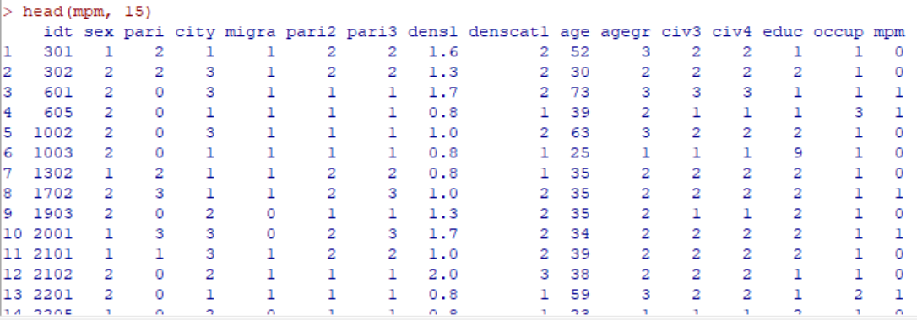
The mpm dataset
Notes:
Yesterday we have seen how factors with two levels can be fitted into a logistic regression model. Remember that the outcome variable of a logistic regression model always has to be binary but the independant variables (predictors) can have more levels. They can be numerical but they can also be categorical. In case of a categorical variable we recode it as a ‘dummy’, similar to what you have seen last week in the linear regression lecture. On this slide you see the first lines of the ‘mpm’ dataset, which as a variable ‘civ4’ which stands for marital status.

Slide 4
Introducing a dummy variable (reminder from linear regression lecture)
 | married(2) | widow(3) | Separated/ divorced (4)
single(1) | 0 | 0 | 0
married(2) | 1 | 0 | 0
widow(3) | 0 | 1 | 0
Separated/divorced(4) | 0 | 0 | 1
Notes:
Variable ‘civ4’ has been coded as 1 (single), 2 (married), 3 (widow) or 4 (separated/divorced). Needless to say that these numbers cannot be interpreted as numerical, 2 married persons does not equal 1 divorced. When using them in a model we have to chose one as our reference category and compare the others to that category. This is in fact not fundamentally different from what we did yesterday for binary categorical factors such as gender. We coded female as ‘TRUE’ and male as ‘FALSE’, which is equivalent to values ‘1’ and ‘0’. So the software will use the category coded ‘0’ or ‘FALSE’ as baseline and calculate the odds ratio for the other category. With a dummy variable we do just the same but we compare, one by one, several other categories to the reference category.

Slide 5
Logistic regression, dummy variables(1)
mpm$case <- mpm$mpm table(mpm$case)
0 1
261 276
table(mpm$civ4)
1 2 3 4
166 327 28 16
Notes:
Outcome variable in this dataset is ‘mpm’, ‘minor psychiatric morbidities’. It is numerical, coded as 0 and 1. Because it is code as 0 and 1 I could use it just as it is but I can also make a factor from it called ‘case’

Slide 6
Logistic regression, dummy variables(2)
GLM.1 <- glm(case ~ civ4, family=binomial, data=mpm)
exp(coef(GLM.1))
(Intercept) civ4
0.577734 1.399551
Notes:
If I run a logistic regression model with ‘case’ as outcome and ‘civ4’ as predictor it will work but the result is meaningless. It tells me my odds of being a case go up by a factor 1.4 if I go from single to married, again by 1.4 if I go from married to widowed and again 1.4 if I go from widowed to divorced

Slide 7
Logistic regression, dummy variables(3)
> GLM.2 <- glm(case ~ factor(civ4), family=binomial, data=mpm)
> exp(coef(GLM.2))
(Intercept) factor(civ4)2 factor(civ4)3 factor(civ4)4
0.6938776 1.8775891 1.2490196 2.4019608
Notes:
To make R use ‘civ4’ as a categorical variable, a dummy variable, just add ‘factor’ and put ‘civ4’ in brackets. The result will be 3 odds ratios, from level 1 to 2, from 1 to 3 and from 1 to 4. Who have the lowest odds?

Slide 8
Logistic regression, dummy variables(4)
> exp(coef(GLM.2))
(Intercept) factor(civ4)2 factor(civ4)3 factor(civ4)4
0.6938776 1.8775891 1.2490196 2.4019608
> exp(confint(GLM.2))
2.5 % 97.5 %
(Intercept) 0.5074694 0.943284
factor(civ4)2 1.2879565 2.749670
factor(civ4)3 0.5519102 2.796780
factor(civ4)4 0.8510180 7.352068
Notes:
If after having run the models we use ‘confint’ we get the confidence intervals. Is there a statistically significant difference between the odds for singles and for any of the other categories. If so, which category?

Slide 9
Logistic regression, dummy variables(5)
> mpm$marstat <- factor(mpm$civ4, levels=1:4, labels=c("single","married","divorced","widowed"))
> table(mpm$marstat)
single married divorced widowed
166 327 28 16
Notes:
To make life easier we can also recode ‘civ4’ to a factor, I called it ‘marstat’ and provided some logical names for the levels.

Slide 10
Logistic regression, dummy variables(6)
> GLM.3 <- glm(case ~ marstat, family=binomial, data=mpm)
> exp(confint(GLM.3))
2.5 % 97.5 %
(Intercept) 0.5074694 0.943284
marstatmarried 1.2879565 2.749670
marstatdivorced 0.5519102 2.796780
marstatwidowed 0.8510180 7.352068
Notes:
Now I run the regression again with ‘marstat’, no need to specify now that it is a factor. The results are of course just the same but now you immediately see the lables of the categories. As we already saw, married people have a significantly higher odds, for the other two categories the association with psychiatric disease is non-significant. So should we keep ‘marstat’ in the model? That depends on whether the model as a whole is significantly better than the null model. If you look in your R output you will see that the null deviance is 744.02 on 536 degrees of freedom, while the residual deviance is 732.16 on 533 degrees of freedom. So the difference is 11.86, with 3 degrees of freedom. If you look it up in Excel or in a Chi square table, you will find that it is statistically significant.

Slide 11
Logistic regression, dummy variables(7)
> anova(GLM.3, test="Chisq")
Analysis of Deviance Table
Model: binomial, link: logit
Response: case
Terms added sequentially (first to last)
Df Deviance Resid. Df Resid. Dev Pr(>Chi)
NULL 536 744.02
marstat 3 11.857 533 732.16 0.007889 **
---
Signif. codes: 0 ‘***’ 0.001 ‘**’ 0.01 ‘*’ 0.05 ‘.’ 0.1 ‘ ’ 1
Notes:
An easier way is to use ‘anova’, which does all the calculations for you. As you can see Chi square is indeed 11.857, with 3 degrees of freedom, resulting in a p-value of 0.007889. So we conclude that on univariate analysis, marital status is significantly associated with pshychiatric disease.

Slide 12
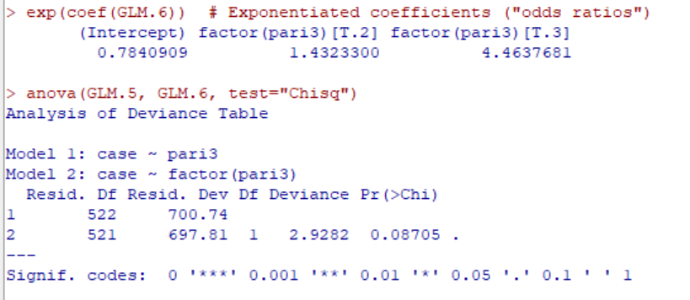
Logistic regression, dummy variables(8) Remove slide???
Notes:
The dataset also has a variable ‘pari3’ which is an ordinal variable, 1 = no children (<15 yrs), 2 = 1-2 children, 3 = 3 or more children. In this case you could consider treating it as a numerical variable because that would simplify your model. There is a clear order here, which was not there in the ‘civ4’ variable. The assumption is that there is a linear trend, that for every level increase in ‘pari3’ there is a constant increase in the odds of ‘case’. On this slide you see the outcome of the categorical model, odds ratios of 1.43 for level 2 (1-2 children) and 4.46 for level 3 (3 or more children). Remember level 1 (no children) is the reference category and therefore has an odds ratio of 1. So we go from 1 to 1.4 to 4.5, not exactly a straight line but if you look at the output of the comparison of the model assuming a linear trend versus the model treating ‘pari3’ as categorical (factor), the difference is just not significant (p=0.08705). So you could consider assuming a linear trend because the model assuming a linear trend is not significantly worse than the model not doing so and the linear trend model is simpler (1 DF saved). In this case it may not be all that meaningful but if for instance you have 5 wealth quintiles, rather than to provide four odds ratios (1-2, 1-3, 1-4 and 1-5), it might be easier to just provide one single odds ratio for each level of increase in wealth. This is only allowed if you can demonstrate that there really is a linear trend, that the model assuming a linear trend is not significantly worse than the model treating wealth quintile as a categorical variable.

Slide 13
Interaction
Interaction: The effect of an exposure on the outcome is modified by a third variable – e.g. a drug is more effective in female than in male individuals: sex = effect modifier
Notes:
Last week we already explored interaction in linear regression. In the exercise we saw that the increase in cholesterol by age was different in two (fictitious) states. Today we will look at the onch1302 dataset to explore whether the effect of living in the forest is different for men than for women.

Slide 14
Interaction (2)
In the Onch1302 dataset living in the forest is associated with increased risk of micro filarial infection (OR 2.4) whereas female gender is protective (OR 0.6).
Could it be that the effect of forest is different for men than for women?
Notes:
In the Onch1302 dataset living in the forest is associated with increased risk of micro filarial infection (OR 2.4) whereas female gender is protective (OR 0.6).
Could it be that the effect of forest is different for men than for women? To answer that question we need to add an interaction term to the model.

Slide 15
Interaction (3)
> onch1302$forest <- onch1302$area
> table(onch1302$forest)
0 1
548 754
> onch1302$female <- onch1302$sex
> table(onch1302$female)
0 1
616 686
> onch1302$case <- onch1302$mf
> table(onch1302$case)
0 1
480 822

Slide 16
Interaction (4)
> GLM.7 <- glm(case ~ forest + female, family=binomial, data=onch1302)
> summary(GLM.7)
Coefficients:
Estimate Std. Error z value Pr(>|z|)
(Intercept) 0.3177 0.1084 2.930 0.00339 **
forest 0.8741 0.1185 7.379 1.59e-13 ***
female -0.4836 0.1191 -4.060 4.90e-05 ***
> exp(coef(GLM.7))
(Intercept) forest[T.1] female[T.1]
1.3739477 2.3967425 0.6165796
Notes:
First we will fit the model with forest and female as predictors, on this slide you see the coefficients and the exponentiated coefficients, the odds ratios. As you can see they are 2.4 for forest and 0.6 for female. Both are highly significant with p-values of 1.59 e-13 and 4.90 e-5 respectively.

Slide 17
Interaction (5)
> GLM.8 <- glm(case ~ forest * female, family=binomial, data=onch1302)
> summary(GLM.8)
Coefficients:
Estimate Std. Error z value Pr(>|z|)
(Intercept) 0.4359 0.1303 3.346 0.000821 ***
forest 0.6519 0.1771 3.682 0.000232 ***
female -0.6965 0.1746 -3.989 6.64e-05 ***
forest:female 0.4010 0.2387 1.680 0.092992 .
> exp(coef(GLM.8))
(Intercept) forest female forest:female
1.5463918 1.9191398 0.4983137 1.4932607
Notes:
Next we fit the model with interaction by adding the term forest*female. You see that an additional term appears in the output. In the exponentiated coefficients you see that the interaction term has an odds ratio of 1.49, female now has an odds ratio of 0.50, forest 1.92.

Slide 18
Interaction (6)
> exp(coef(GLM.8))
(Intercept) forest female forest:female
1.5463918 1.9191398 0.4983137 1.4932607
Male savannah Ref
Female savannah 0.50
Male Forest 1.92
Female Forest 0.50*1.92*1.49 = 1.43
OR Fem. savannah –> Fem. forest => 1.43/0.50 = 2.86
Male savannah –> Male forest => 1.92/1 = 1.92
Notes:
We now have three terms in our model, ‘forest’, ‘female’ and the interaction term. The reference category are those for whom the value of ‘female’ and the value of ‘forest’ are both zero, so men living in the savannah. Compared to them women living in the savannah have 2 times lower odds of being a case. Men living in the forest have almost twice higher odds (1.9) of disease than men living in the savannah. For the odds women in the forest compared to the reference category, men living in the savannah, we have to consider three odds ratios. For being a woman the odds are 0.50 compared to men, for living in the forest the odds are 1.9 compared to living in the savannah. On top of that there is the odds of the interaction term if you are both a woman and living in the forest, so 1.4 times higher odds than the reference category. But if you compare a woman living in the forest to a woman living in the savannah, het odds will be 1.92*1.49 = 2.86 times higher.

Slide 19
Interaction (7)
> onch_m <- onch1302[onch1302$female==0,]
> onch_f <- onch1302[onch1302$female==1,]
> GLM.9 <- glm(case ~ forest, family=binomial(logit), data=onch_m)
> exp(coef(GLM.9))
(Intercept) forest
1.546392 1.919140
> GLM.10 <- glm(case ~ forest, family=binomial(logit), data=onch_f)
> exp(coef(GLM.10))
(Intercept) forest[T.1]
0.7705882 2.8657761
Notes:
An easier way to see the odds ratios for men and women separately is to split the dataset in men and women, using the ‘subset’ command in R. The expression ‘female==0’ will select only men, ‘female==1’ will select only women. If on these datasets we do a logistic regression with only forest as predictor (since gender does not vary within these datasets), we get the same 1.92 for men and 2.87 for women.

Slide 20
Interaction (8)
OR for ‘Forest’, controlled for gender is 2.4 but if we look separately at the two genders it’s 1.9 for men and 2.9 for women
Is this difference enough to justify the choice for a more complex model?
Principle of parsimony
Use LR test to compare models
Notes:
The OR for ‘Forest’, controlled for gender is 2.4 but if we look separately at the two genders it’s 1.9 for men and 2.9 for women. Is this difference enough to justify the choice for a more complex model? That depends on whether or not the complex model with interaction term is significantly better than the simple model without interaction term. An LR test can tell us whether this is the case.

Slide 21
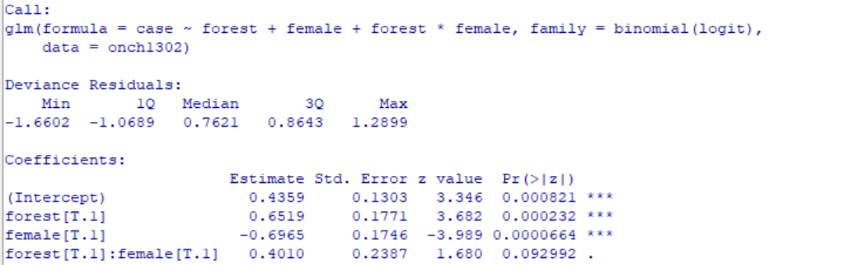
Interaction (9)
This p are for the wald test
Red: it is not a significant effect of the forest*female. So is not an interaction (we dont have enough evidence)
Notes:
As a first indication we can already look at the Wald test of the interaction term, which is part of the standard output. It has a p-value of 0.093, so non-significant. If you have one single interaction term, because both ‘forest’ and ‘female’ are binary variables, this is easy to see. But if you would have a variable such as socio-economic status in wealth quintiles, you would have at least 4 interaction terms. Some may be significant, others not, but is does the interaction as a whole make the model significantly better? To answer that question we need to do a likelihood ratio test. Run the two models and use ‘Models’, ‘Hypothesis tests’, ‘Compare two models’ to get the value for the likelihood ratio test.

Slide 22
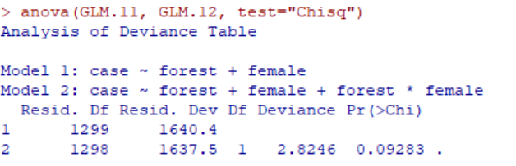
Interaction (10)
GLM.11 <- glm(case ~ forest + female, family=binomial(logit), data=onch1302)
GLM.12 <- glm(case ~ forest + female + forest*female, family=binomial(logit), data=onch1302)
anova(GLM.11, GLM.12, test="Chisq")
Notes:
Model 11 is without interaction term, model 12 with. If you compare the two you get a Chi square value of 2.82 with 1 degree of freedom, which is not statistically significant. The associated p-value is 0.093. So the model with interaction is not significantly better than the model without interaction, in that case we opt for the simple model (without interaction) based on the principle of parsimony.

Slide 23
Interaction (11)
Some hints when testing for interactions:
In an explanatory model only test for interaction between primary exposure and one secundary exposure at a time
Restrict to biologically plausible interactions to avoid chance results
Testing for interaction works best if both variables are binary
Notes:
Finally a few hints for testing interactions. If you have many factors in your model and you just blindly test for all possible interactions, you may run into associations that are by chance statistically significant. Remember with a p-vaule of 0.05 you accept a 5% possibility to wrongly reject the null hypothesis that there is no interaction (α-error). In an explanatory model only test for interaction between primary exposure and one secundary exposure at a time. Restrict to biologically plausible interactions. You can also run into a β-error, wrongly not rejecting your null-hypothesis of no interaction. The risk of a β-error is increased if you use a variable with more than two levels. Testing for interaction works best if both variables are binary

Slide 24
Summary of Lecture 2
Categorical variables can be coded as numbers but should not be treated as such
In case of a binary variable use ‘0’ or ‘FALSE’ if not present and ‘1’ or ‘TRUE’ if present.
For variables with more than two levels recode to a factor or add ‘factor’ in the model
In case of an ordinal categorical factor with more than two levels you may check for a linear trend

Slide 25
Summary of Lecture 2 (2)
An interaction term can be added to a model by adding ‘factor1*factor2’ to the equation
Odds for each level of exposure can be calculated from odds ratios presented, easier is to just split the dataset in those with and without the effect modifier
Use LR test to decide whether model with interaction is signifcantly better than model without
Be cautious when testing multiple interactions, risk of α-error
Best recode to two levels only, risk of β-error

